Slide 1
Village of Hampshire Capital Improvement Plan FY 2024 update

Slide 2
Presentation Overview
Introduction to Capital Planning
Planning and Approval Process
FY 2023 Review
FY 2024 Budgeted Items
FY24-26 Spending Summary

Slide 3
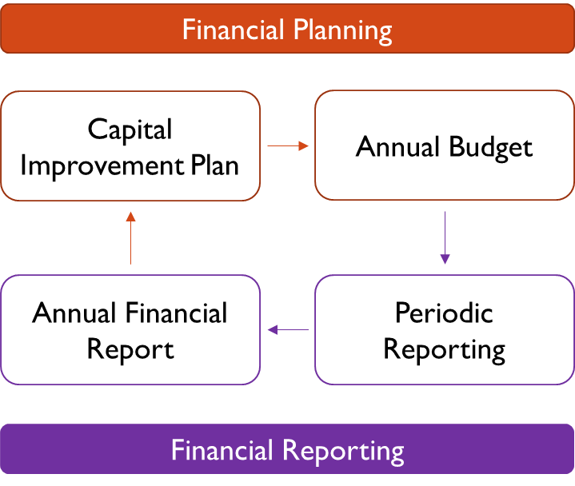
Introduction to cip
Purpose = long-term thinking
Capital Plan – not policy
Expenditures are in annual budgets
Updated annually during budgeting

Slide 4
Process
Identify and Prioritize Needs
Department Needs
Projects
State Mandates
Funding Sources
Evaluate Financial Constraints
Committee and Village Board Feedback
Capital Improvement Plan

Slide 5
FY 2023 Review
 | Original CIP | Actual
Infrastructure | $ 1,769,735 | $ 3,028,425
Fleet | $ 467,843 | $ 356,153
Buildings | $ 68,423 | $ 10,200
Streets Equipment | $ 40,000 | $ 0
Utilities Equipment | $ 355,000 | $ 373,133
Police Equipment | $ 0 | $ 51,722
Total | $ 2,456,970 | $ 3,700,610
Major Accomplishments
Streetscape
Water System Connection (unplanned)
Rt. 72 & State Street Intersection
Centennial Drive Resurfacing
Wheel Loader
1-Ton Trucks
SCADA Upgrades
Channel Grinder
Utilities Master Plan
Police Squad Tech (unplanned)
Postponed
Streets Garage – FY24
Replace 2003 Snow Plow – FY24
Surge Suppression – FY24
Asphalt Hopper – FY24

Slide 6
Future Spending Summary
Original CIP (‘22) New CIP
Infrastructure $ 22,607,112 $ 19,702,276
Fleet $ 1,422,680 $ 1,183,128
Buildings $ 7,740,584 $ 7,883,235
Streets Equipment $ 252,381 $ 298,000
Utilities Equipment $ 3,391,500 $ 27,440,836
Police Equipment $ 62,000 $ 165,400
______________________________________________________________________
Total $36,901,722 $ 56,672,875

Slide 7
FY24-26 Spending summary
 | FY24 | FY25 | FY26 | Total |  | Known Future Expenditures | Grand Total
Infrastructure | $ 937,955 | $ 336,000 | $ 427,000 | $ 1,700,955 |  | $ 18,001,321 | $ 19,702,276
Fleet | $ 194,790 | $ 404,338 | $ 134,000 | $ 733,128 |  | $ 450,000 | $ 1,183,128
Buildings | $ 208,323 | $ 184,523 | $ 185,723 | $ 578,570 |  | $ 10,011,788 | $ 10,589,764
Streets | $ 93,000 | $ 110,000 | $ 95,000 | $ 298,000 |  | $ - | $ 298,000
Utilities | $ 828,836 | $ 687,000 | $ 700,000 | $ 2,215,836 |  | $ 32,200,000 | $ 34,415,836
Police | $ 100,100 | $ 32,510 | $ 32,510 | $ 165,120 |  | $ 520 | $ 133,650
Total | $ 2,363,004 | $ 1,754,668 | $ 1,574,233 | $ 5,691,609 |  | $ 60,663,629 | $ 66,354,644

Slide 8
FY 2024 Budgeted items
Infrastructure | $ 937,955
Fleet | $ 194,790
Buildings | $ 208,323
Streets Equipment | $ 93,000
Utilities Equipment | $ 828,836
Police Equipment | $ 100,100
Total | $ 2,363,004
Rt. 72 & State Final Payment - $70,000
Safe Routes to School Engineering - $35,000
Duchess Resurfacing - $135,000
Park & Rinn Stormwater Project - $697,955

Slide 9
FY 2024 Budgeted items
Infrastructure | $ 937,955
Fleet | $ 194,790
Buildings | $ 208,323
Streets Equipment | $ 93,000
Utilities Equipment | $ 828,836
Police Equipment | $ 100,100
Total | $ 2,363,004
Replace 2003 Snowplow - $194,790

Slide 10
FY 2024 Budgeted items
Infrastructure | $ 937,955
Fleet | $ 194,790
Buildings | $ 208,323
Streets Equipment | $ 93,000
Utilities Equipment | $ 828,836
Police Equipment | $ 100,100
Total | $ 2,363,004
Pumping Station Lighting - $25,000
Police Dept. Lease with Remodel - $74,247
Streets Garage - $109,076

Slide 11
FY 2024 Budgeted items
Infrastructure | $ 937,955
Fleet | $ 194,790
Buildings | $ 208,323
Streets Equipment | $ 93,000
Utilities Equipment | $ 828,836
Police Equipment | $ 100,100
Total | $ 2,363,004
Electrical Upgrades for Trucks - $13,000
Mobile Office Trailer - $20,000
Asphalt Hopper - $30,000
Hauling Trailer - $30,000

Slide 12
FY 2024 Budgeted items
Finish Utilities Master Plan - $50,000
*NARP Phase II and III- $181,000
*Source Water Protection Plan - $5,711
*Lead Service Line Program - $30,000
DMP Repair - $22,125
Thickener Pump Rehab - $40,000
Sewage Pumping Station VFD Repair - $28,000
WTP 9 Brine Tank Repair - $14,000
WTP 9 Media Exchange – 140,000
WTP 10/13 Brine Tank Repair - $14,000
WTP 10/13 Brine Meter Replacement - $15,000
Pumping Station Lighting - $25,000
WWTP Manhole Rehab – $30,000
Surge Suppression (13) - $259,000
Infrastructure | $ 937,955
Fleet | $ 194,790
Buildings | $ 208,323
Streets Equipment | $ 93,000
Utilities Equipment | $ 828,836
Police Equipment | $ 100,100
Total | $ 2,363,004

Slide 13
FY 2024 Budgeted items
Infrastructure | $ 937,955
Fleet | $ 194,790
Buildings | $ 208,323
Streets Equipment | $ 93,000
Utilities Equipment | $ 828,836
Police Equipment | $ 100,100
Total | $ 2,363,004
Server Upgrade - $30,000
Livescan Machine Upgrade - $21,000
Replace Desktops PCs (4) - $6,000
*Body Cameras with Data Storage - $43,100

Slide 14
FY24-26 Spending summary
 | FY24 | FY25 | FY26 | Total |  | Known Future Expenditures | Grand Total
Infrastructure | $ 937,955 | $ 336,000 | $ 427,000 | $ 1,700,955 |  | $ 18,001,321 | $ 19,702,276
Fleet | $ 194,790 | $ 404,338 | $ 134,000 | $ 733,128 |  | $ 450,000 | $ 1,183,128
Buildings | $ 208,323 | $ 184,523 | $ 185,723 | $ 578,570 |  | $ 10,011,788 | $ 10,589,764
Streets | $ 93,000 | $ 110,000 | $ 95,000 | $ 298,000 |  | $ - | $ 298,000
Utilities | $ 828,836 | $ 687,000 | $ 700,000 | $ 2,215,836 |  | $ 32,200,000 | $ 34,415,836
Police | $ 100,100 | $ 32,510 | $ 32,510 | $ 165,120 |  | $ 520 | $ 133,650
Total | $ 2,363,004 | $ 1,754,668 | $ 1,574,233 | $ 5,691,609 |  | $ 60,663,629 | $ 66,354,644

Slide 15
Future Spending Summary
Original CIP (‘22) New CIP
Infrastructure $ 22,607,112 $ 19,702,276
Fleet $ 1,422,680 $ 1,183,128
Buildings $ 7,740,584 $ 7,883,235
Streets Equipment $ 252,381 $ 298,000
Utilities Equipment $ 3,391,500 $ 27,440,836
Police Equipment $ 62,000 $ 165,400
______________________________________________________________________
Total $36,901,722 $ 56,672,875

Slide 16
Fleet

Slide 17
Buildings

Slide 18
Streets dept.

Slide 19
Utilities Dept.

Slide 20
Utilities Dept. Continued

Slide 21
Police Dept.

